Slide 1

Chicago Writers Block
By Team Pinnacle

Slide 2
Chicago Writers Block
Idea
Create a resource that is a collection of information on authors local to the Chicago area
Concept
Starting point for someone looking into the Chicago literary community
Not intended to be an academic resource
Audience
Literary hobbyist
Those interested in Chicago history

Slide 3
Chicago Writers Block
Design inspiration
Mapping the Republic of Letters
http://republicofletters.stanford.edu/casestudies/index.html
Simple streamlined design
Travel Paris by Art
http://travelbyart.com/
Similar concept, discover art by location
Book Recommendations by Readers
http://whatshouldireadnext.com/
Interactive for the user, provides reading suggestions

Slide 4
Chicago Writers Block
Design goals and ideas
Chicago flag color theme
Intuitive use for the user
Interactive to keep user’s attention
Resources to a variety of information for the user

Slide 5
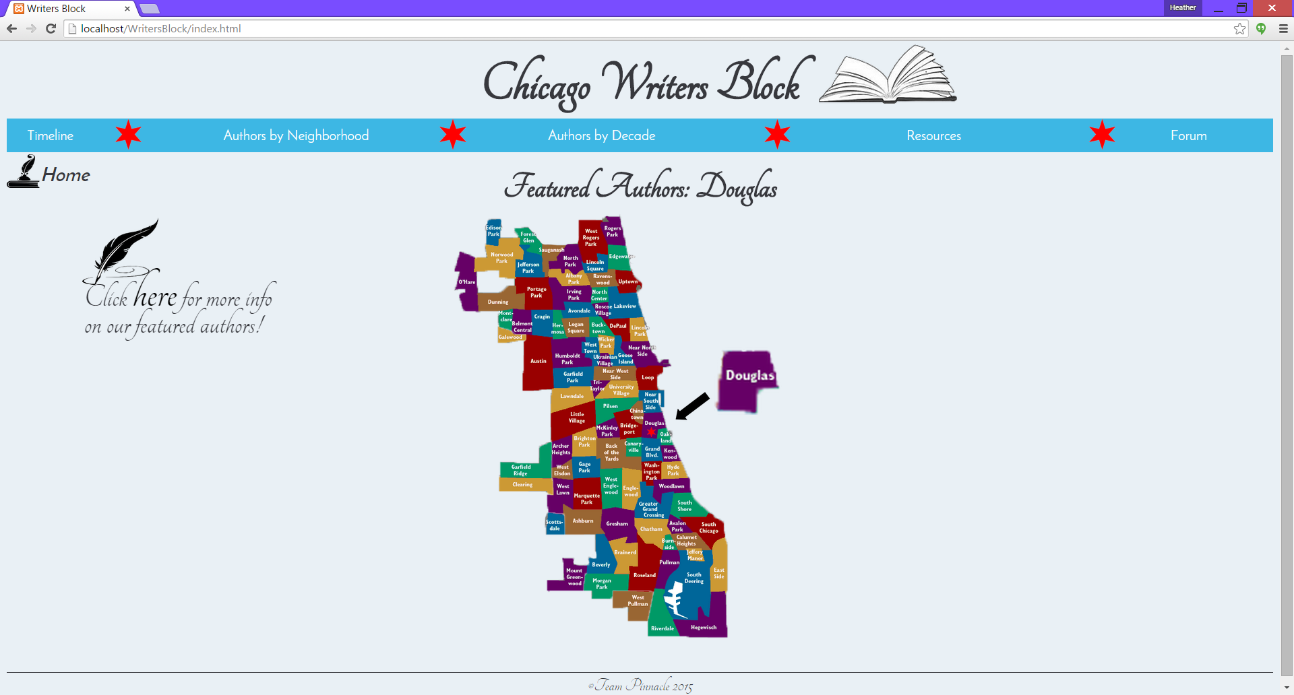
Chicago Writers Block
Homepage

Slide 6
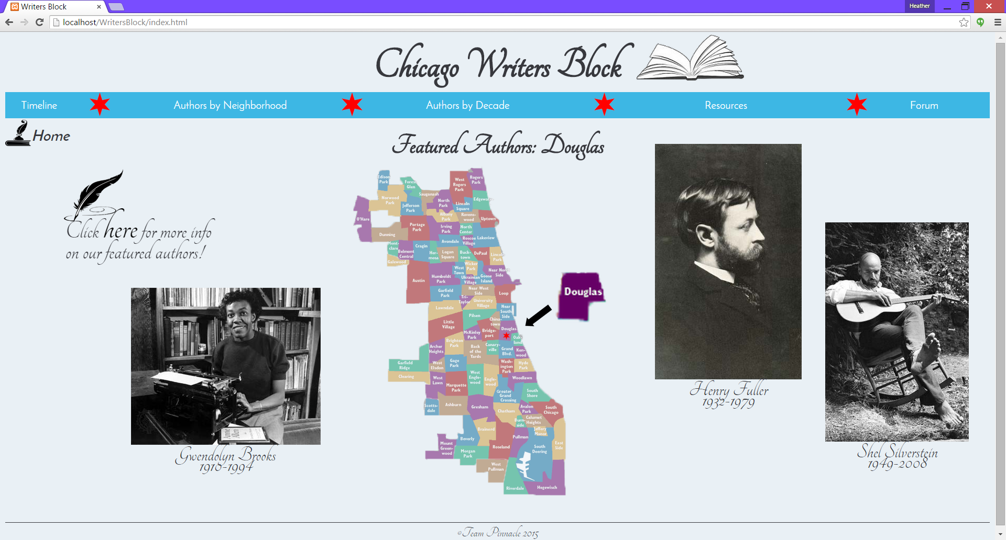
Chicago Writers Block

Slide 7
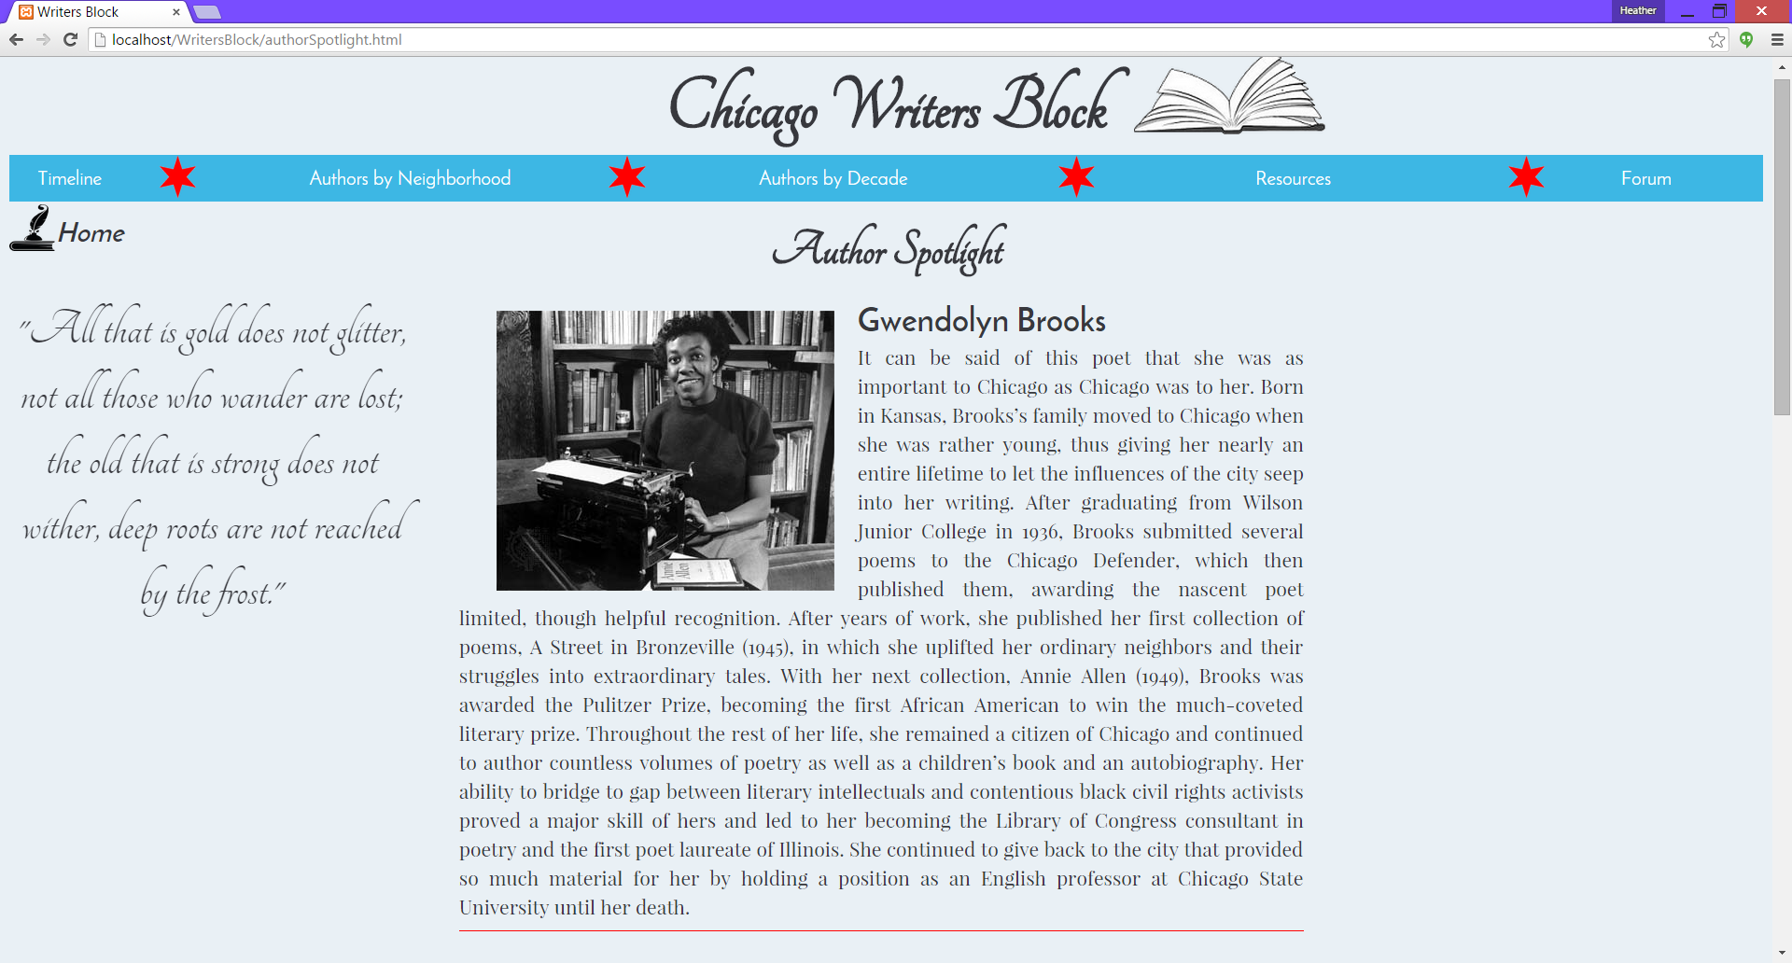
Chicago Writers Block
Author spotlight

Slide 8
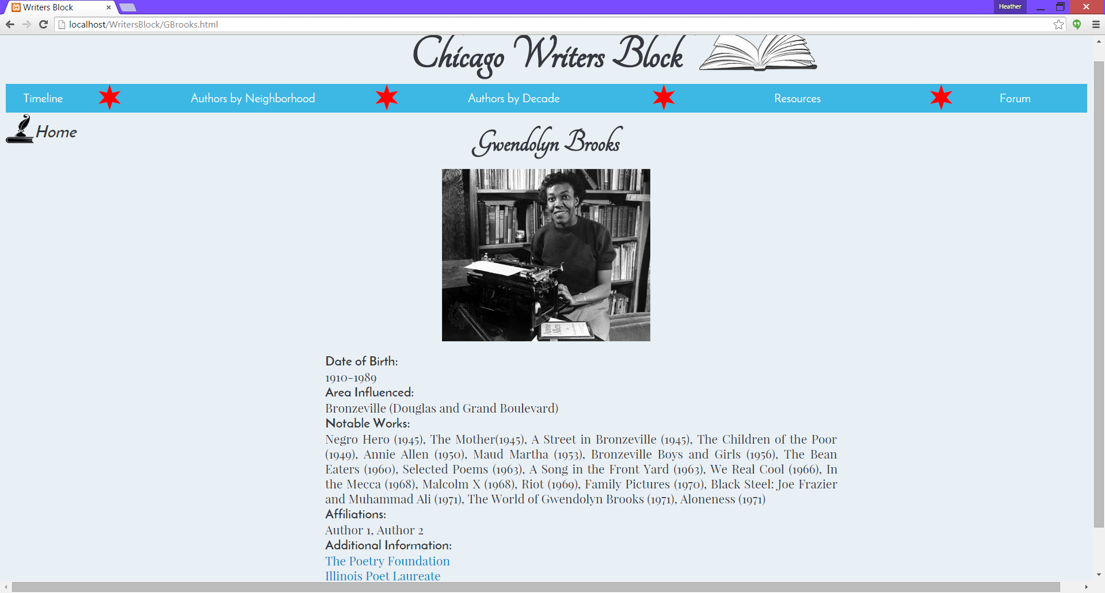
Chicago Writers Block
Author page

Slide 9
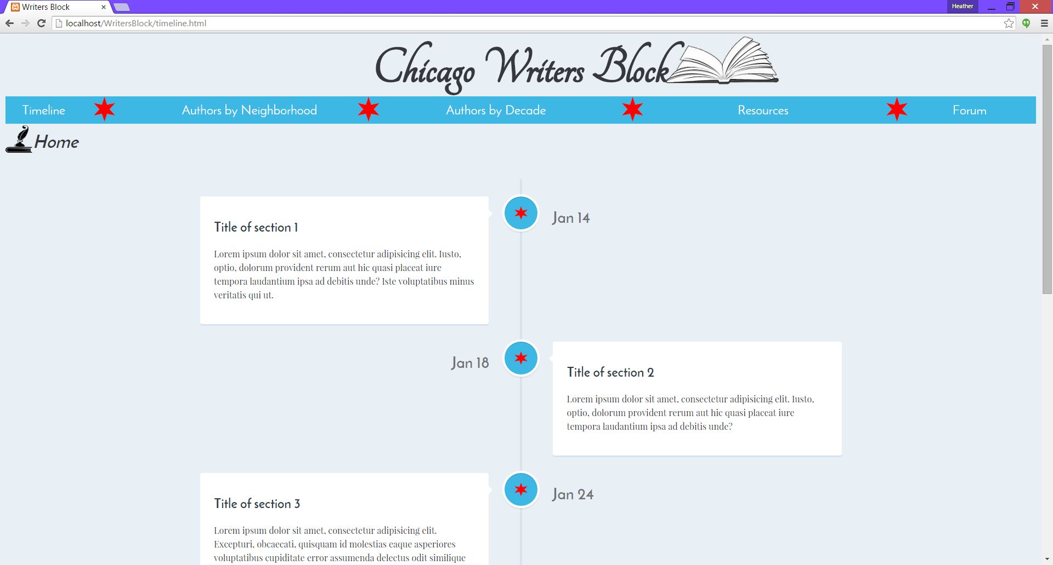
Chicago Writers Block
Timeline

Slide 10
Chicago Writers Block
Additional features
Forum
Resources page with map
Data divided by neighborhood and decade
Search feature

Slide 11
Chicago Writers Block
Thank you!

